Slide 1


Slide 2

ONLINE SHOE STORE
Batch – 87
Team Members:
Balakrishna D
Shashanka H
Ganya H T
Rahul G N

Slide 3
Contents
Introduction
Problem Statement
Proposed Solution
Design
Technologies
Screenshots

Slide 4
INTRODUCTION
An online Shoe Store allow online ordering , or a standalone e-commerce service that includes all type of Shoe items.
The project is implemented with regard to buying and selling of the shoes.
This project provides the users basically the online shoes and the customer can interface for viewing and buying of shoes.
Our project provides the simple and easy GUI for the users.

Slide 5
PROBLEM STATEMENT
This project aims to develop an Online shoe store E-commerce website.
This provides an easy way to sell products to a large customer base.
However, there is a lot of competition among multiple e-commerce sites.
When users land on an e-commerce site, they expect to find what they are looking for quickly and easily.
Also, users are not sure about the brands or the actual products they want to purchase.

Slide 6
PROPOSED SOLUTION
The customer and the admin are the two parties which are allowed to have access to the database of the system and have different view level schemas’ to the database information
The customers are privileged with the following services :
Register as a customer by providing certain personal details .
View products and add them to the cart also remove and change items.
View orders details.

Slide 7
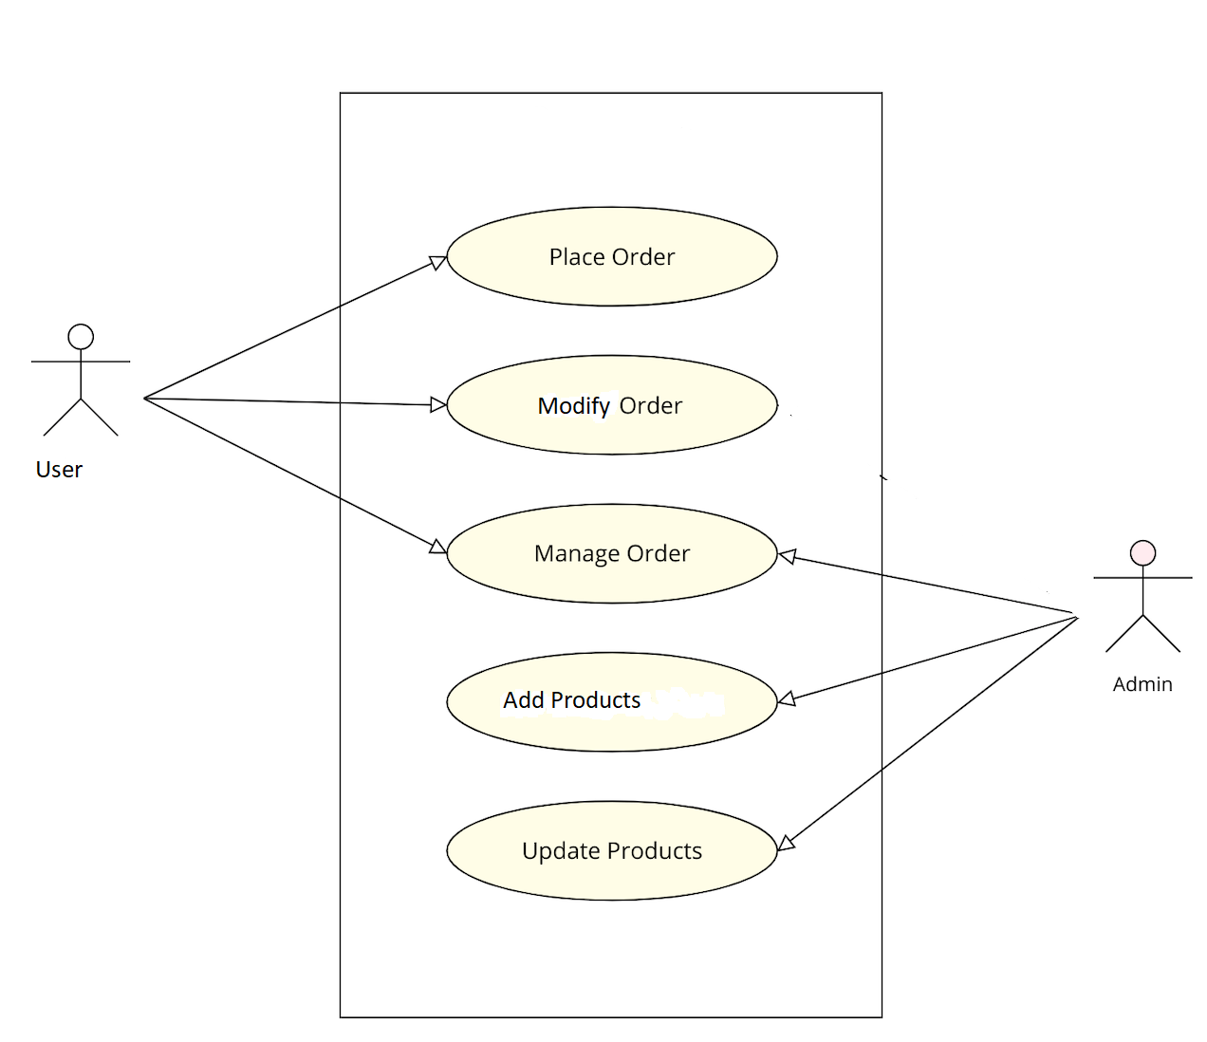
SYSTEM DESIGN

Slide 8
REQUIREMENTS
Front end : HTML,CSS
Back end : Mysql , Java
Platform Technologies : Eclipse , Heidisql
FrameWork : Java Spring Boot

Slide 9
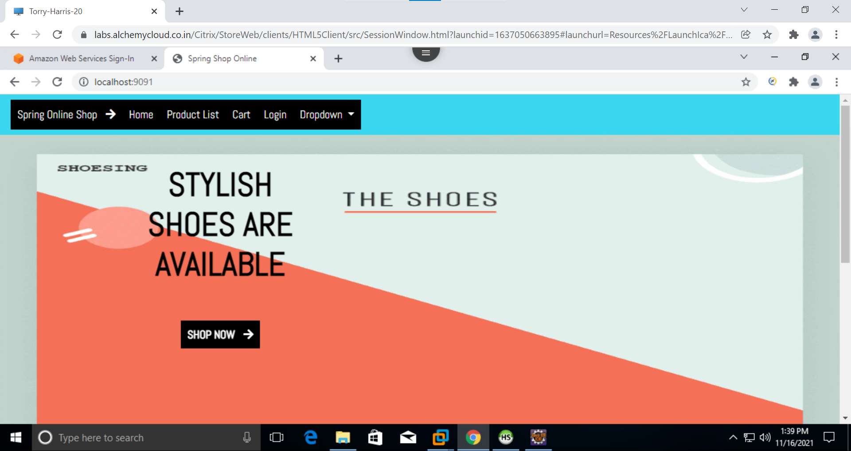
SCREENSHOTS
HOME PAGE

Slide 10
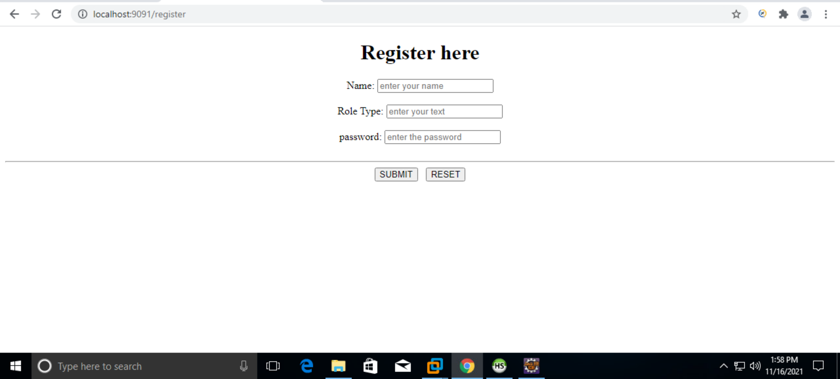
REGISTER PAGE

Slide 11
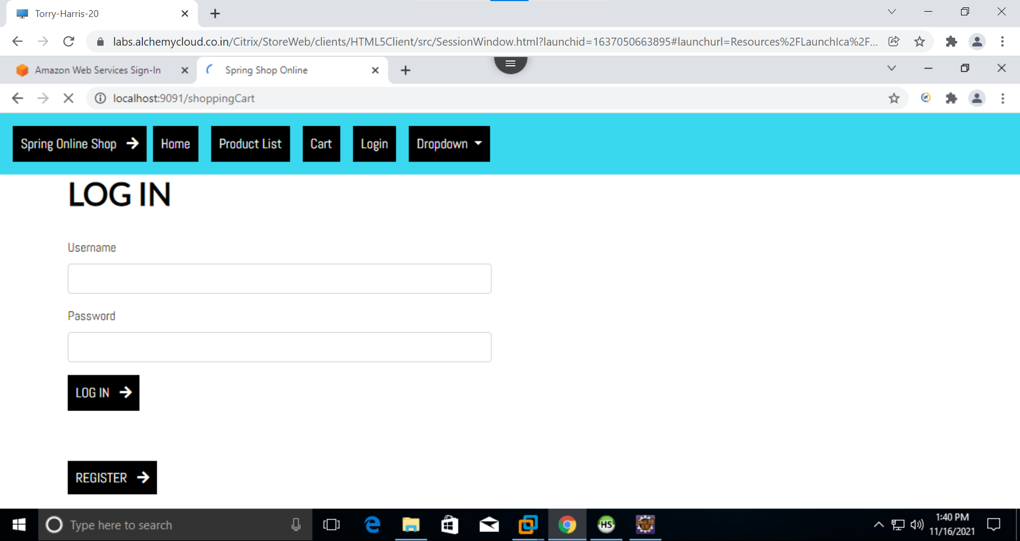
LOGIN PAGE

Slide 12
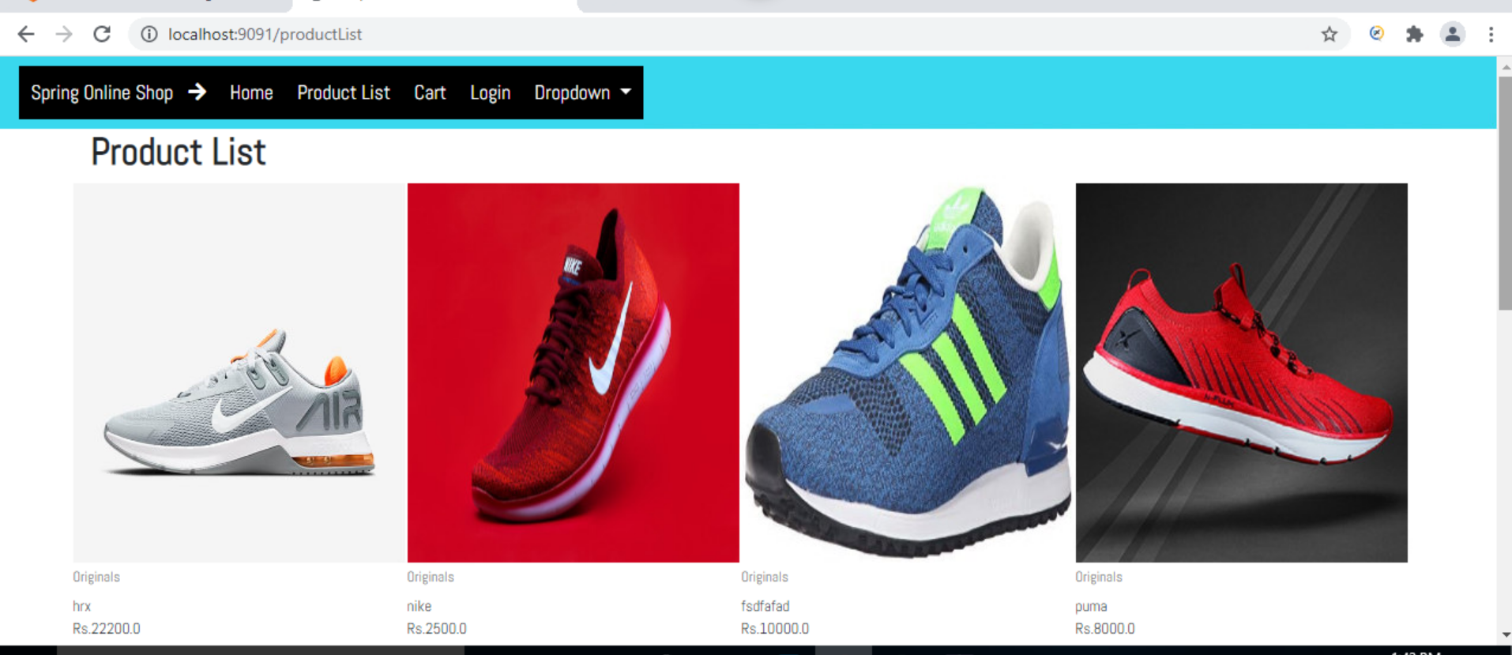
PRODUCT LIST

Slide 13
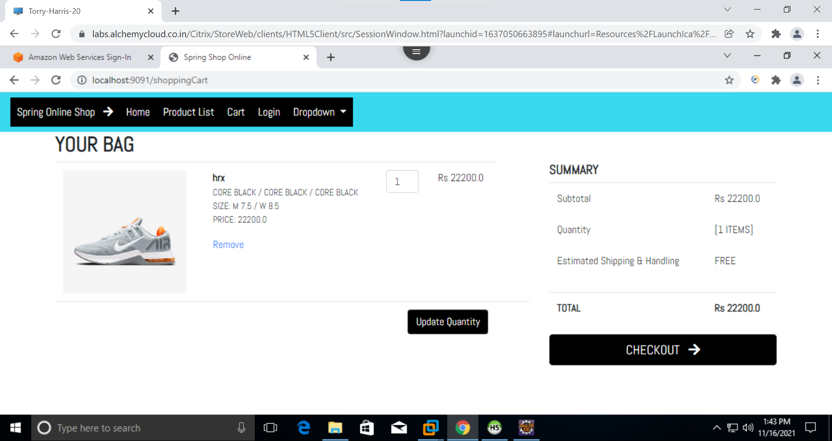
CART PAGE

Slide 14
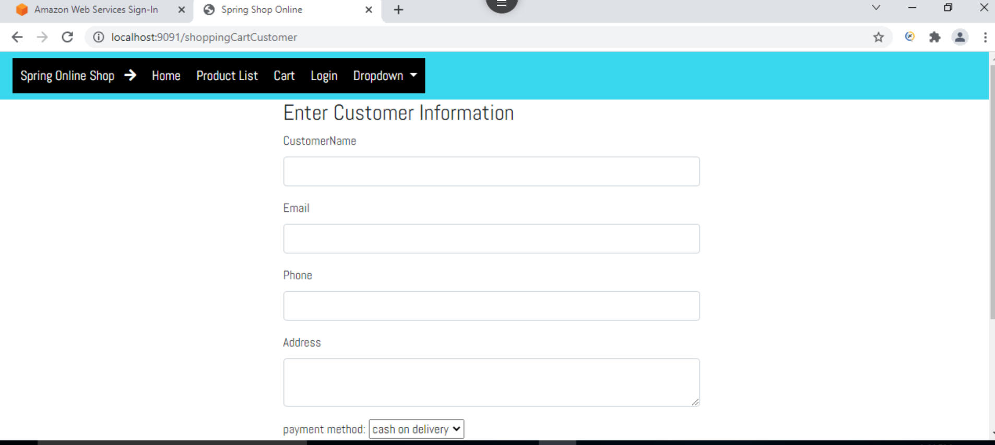
CUSTOMER INFORMATION PAGE

Slide 15
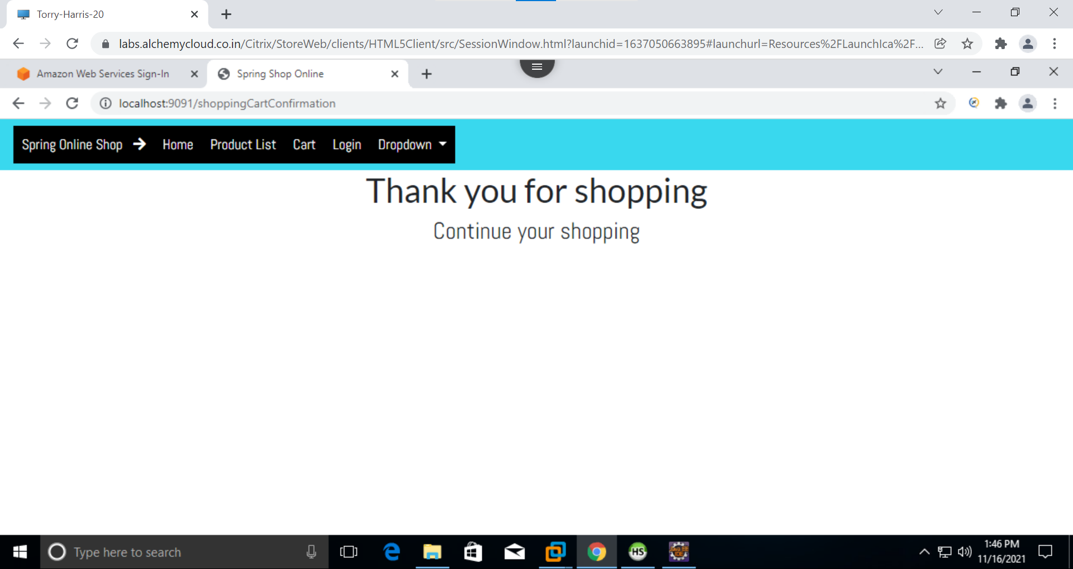
ORDER CONFIRMATION PAGE

Slide 16


